Slide 1
ICT PROJECT PRESENTATION
NAME :
AIN-UL-HAQ FATIMA
REG NO :
BCY 243060
NAME :
ALEENA HASSAN
REG NO :
BCY243062
SUMITTED TO :
SIR WAQAS
PAGE NO 1

Slide 2
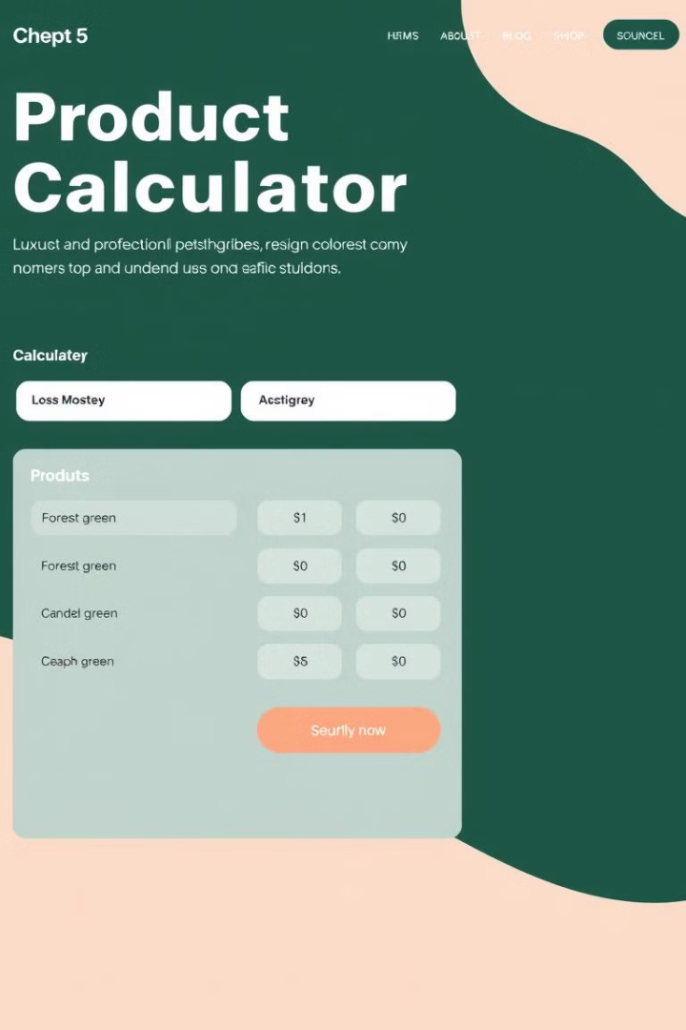
Product Price Calculator with Bulk Discount
This presentation outlines the development and implementation of a product price calculator with bulk discount functionality, a valuable tool for optimizing pricing strategies and enhancing customer satisfaction.
PAGE NO 2

Slide 3
Introduction
Motivation
Objectives
Develop a user-friendly and accurate calculator to streamline pricing for various products, ensuring competitive pricing while providing bulk discounts.
Enhance customer experience, optimize pricing strategies, and maximize sales through transparent pricing and attractive incentives for bulk purchases.
PAGE NO 3

Slide 4
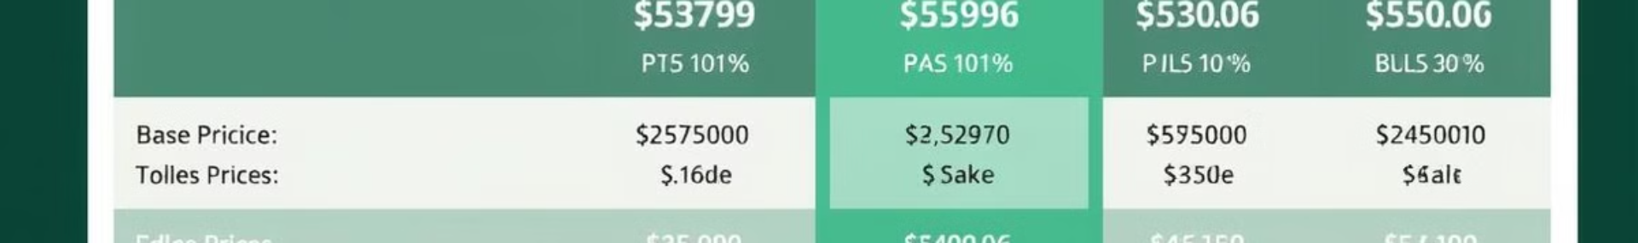


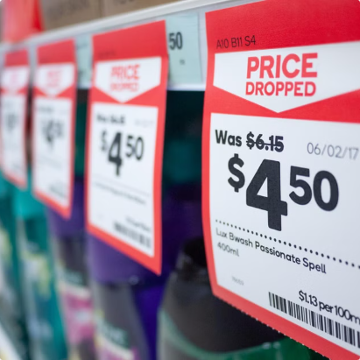
This slide details our product pricing, including the base price, bulk discount tiers, and the discount calculation formula.
Base Price
Bulk Discount Tiers
Discount Formula
The starting price for a single product unit.
Order quantity ranges with corresponding discount percentages.
The calculation for price reduction based on quantity and tier.
PAGE NO 4

Slide 5
Bulk Discount Calculations
Quantity Ranges
1
Establish clear thresholds for each bulk discount tier, e.g., 10-20 units, 21-50 units.
Discount Percentage
2
Define the percentage discount applied within each quantity range, e.g., 5% for 10-20 units, 10% for 21-50 units.
Price Calculation
3
Multiply the base price by the discount percentage, then subtract the result from the base price to determine the discounted price.
PAGE NO 5

Slide 6
Pricing Scenarios and Examples
1
10
$450
Base Price
Quantity
Discounted Price
$50
10
$450 (10% discount)
25
$1,062.50
Quantity
Discounted Price
25
$1,062.50 (15% discount)
PAGE NO 6

Slide 7
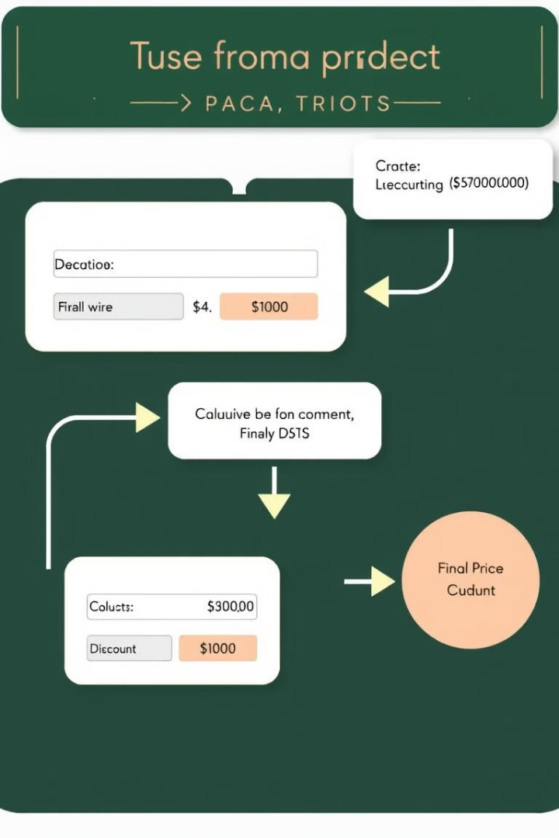



Main Functions
Quantity Input
Discount Calculation
Allow the user to input the desired quantity of the product.
Apply the appropriate discount based on the quantity tier.
Price Display
Display the final discounted price to the user.
PAGE NO 7

Slide 8



Integrating the Calculator into the Website
Front-End Integration
Embed the calculator's HTML and CSS code into the product page using JavaScript.
1
Back-End Integration
2
Connect the front-end calculator to the back-end database to retrieve product information and discount tiers.
User Interface Design
3
Ensure a user-friendly interface that is easy to understand and navigate.
PAGE NO 8

Slide 9




Utilizing the Calculator for Sales and Marketing
Promotional Campaigns
Highlight the bulk discount feature in marketing materials and social media promotions.
Personalized Recommendations
Use the calculator to recommend relevant discount offers based on customer browsing and purchase history.
Sales Funnel Optimization
Integrate the calculator into the checkout process to offer discounts at the point of purchase.
PAGE NO 9

Slide 10



Collecting Customer Feedback ::
Customer Feedback Insights on Product Price Calculator
User Experience: Users appreciate a user-friendly interface with clear instructions.
Functionality: Accurate calculations and effective discount application are crucial for user satisfaction.
Input Validation: Robust input validation is valued, especially preventing negative values.
Performance: Users expect quick and efficient calculations, even with large quantities.
PAGE NO 10

Slide 11

Conclusion and Next Steps
The product price calculator with bulk discount functionality is a valuable asset for optimizing pricing strategies, enhancing customer satisfaction, and boosting sales. Future development will include integrating advanced features like dynamic pricing based on market demand and personalized recommendations to further optimize pricing and customer experience.

